Slide 1
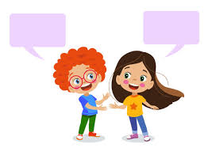
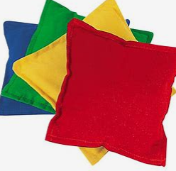
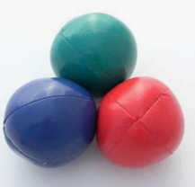
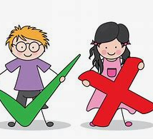
Reception Newsletter
Spring 1 – 2024/25
Notices and Reminders
Our PE day will be on a Friday - the children should come to school in their PE kit.
Book change day is on a Friday. Ensure the reading record in brought in on this day.
Key dates
Friday 17 January – INSET day
Friday 14 February – last day of Spring 1
Communication and Language
The children are learning how to answer a range of who, when, how questions. They are learning how to pose their own questions about the texts and the topics they are learning about. They are learning how to extend their sentences using words such as because to add more detail to what they are saying. Through 'Show and Tell', the children are developing their confidence to speak in front of their class.
Physical Development
In gross motor this half term, the children are learning how to throw an object and the best way to catch an object. This will incorporate the throwing and catching of bean bags before moving onto balls. They will use these skills to practise throwing and catching with a partner.
Personal, Social and Emotional Development
The children are thinking about rules, why they are needed and how they help them during their day. The children are exploring the concepts of right and wrong, and they are turn taking and sharing with their friends. They will also learn the importance of resilience and persevering in learning and more widely.

Slide 2
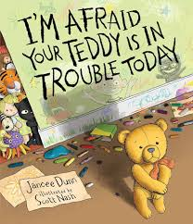
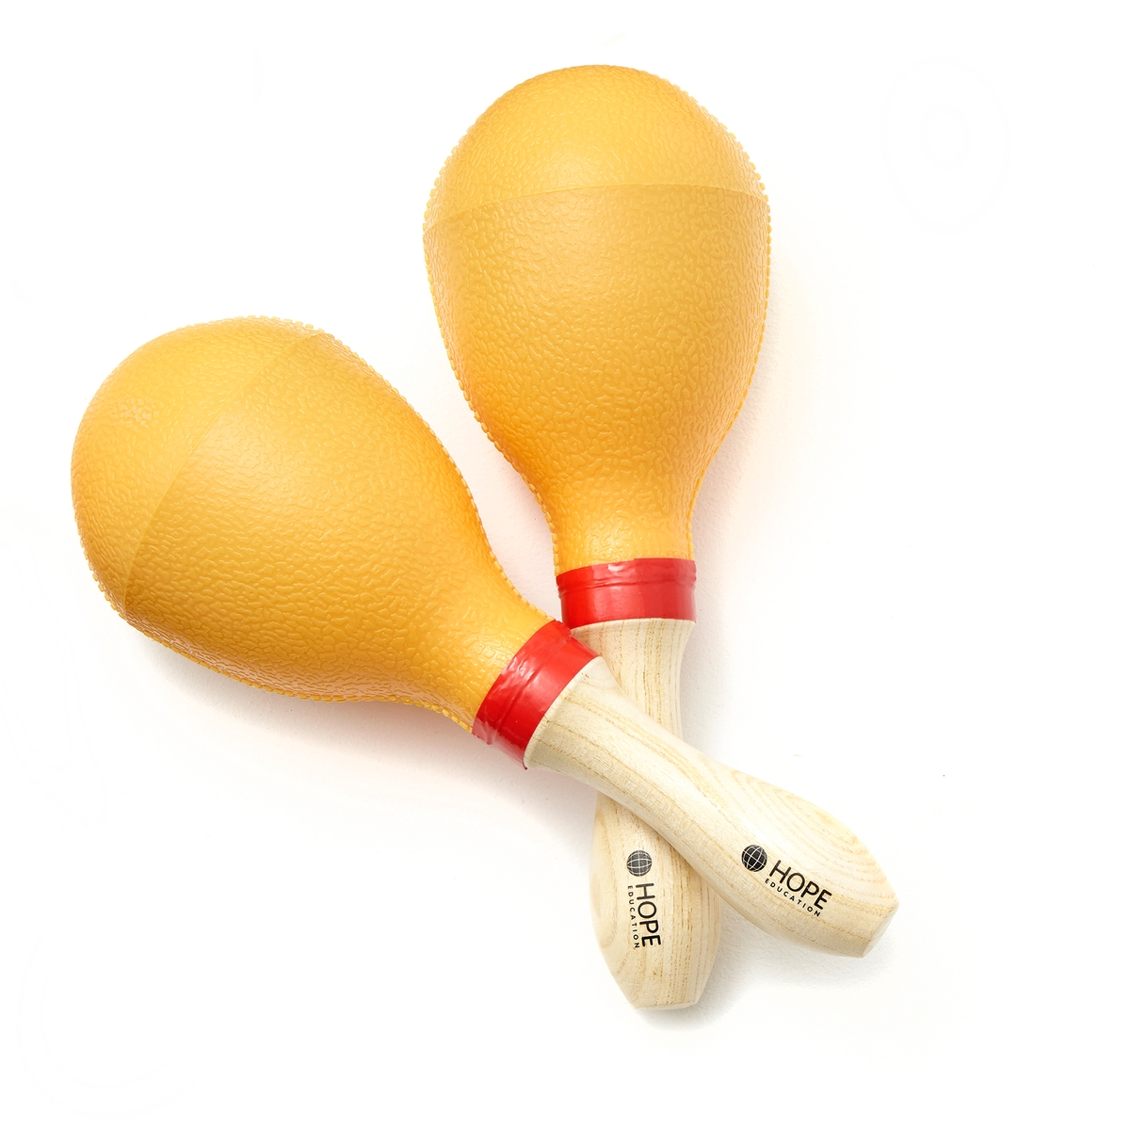
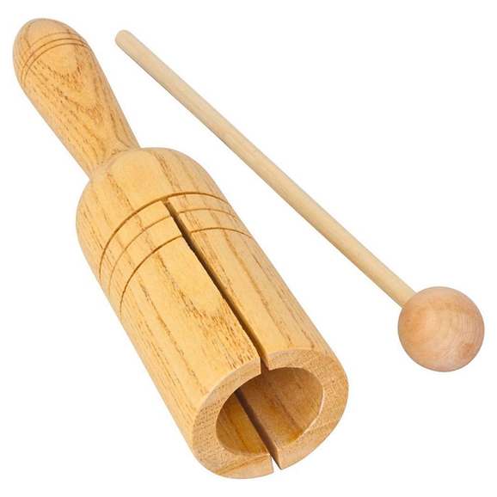
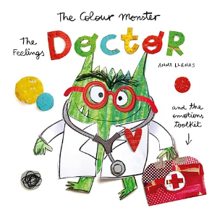
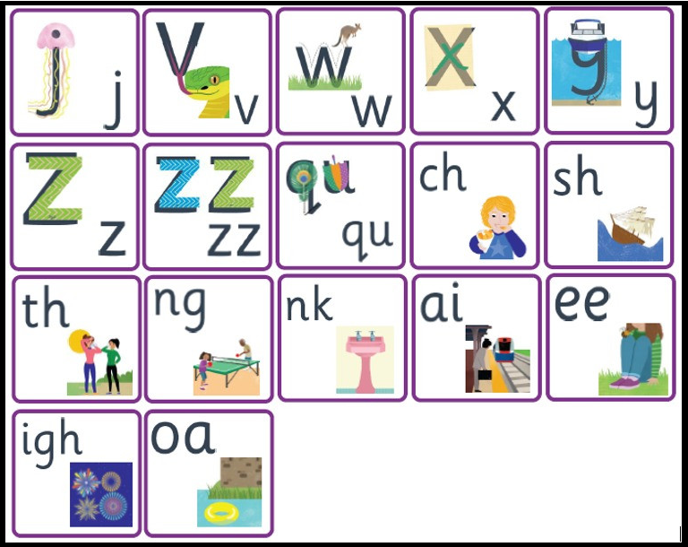
Literacy
In phonics the children are learning the last of the phase 3 digraphs and trigraphs. They are reading words with these in and beginning to write words, captions and sentences using these new sounds.
Rich texts are used to develop the children's writing. They will orally rehearse them, act them out and begin to write them with a focus on finger space and full stops.
Mathematics
In maths the children are consolidating their knowledge of numbers from 1-5, along with learning that zero is the absence of something.
The children are consolidating their subitising skills by recalling an amount without having to count each item. The children use physical resources to calculate one more and one less than a given number.
Understanding the World
In understanding of the world the children are learning about people in the community who help us. Initially they are learning about doctors, nurses and paramedics. This will be linked with our bodies and how we can keep healthy.
Next, they will learn about the police and how they help us. Finally, they will learn about the fire brigade and fire safety.
The children will also learn about materials investigating their appropriateness for a purpose. This will be linked with expressive arts and design.
Expressive Arts and Design
In expressive art and design the children are exploring percussion instruments. The children are focussing on percussion instruments, exploring the sounds they make and beginning to create musical patterns using untuned instruments.
The children are learning more about materials and their uses. They are exploring creating using a range of materials and joining techniques.
Homework
Please continue to read with your child five times a week. You will receive a handout in your child’s bag with phonemes we have been teaching and reviewing.
Suggested books for reading

